Slide 1





Hatley
Project
Information System Department
Academic supervisor:
Dr/ Ali Hussein

Slide 2

Team Member
1
Abdullah Salah
2
Ahmed Ali Farahan
3
AbdelRahman Omar
4
Santy Osama Mina
5
Rahma Bahaa

Slide 3

What is the Problem?
1-User perspective
2-Delivery perspective

Slide 4

User Perspective
Daily essential
Busy schedule
Delay of delivery company
4. Lack of access to wide range product
5. Small and medium sized stores
6. The greed of delivery men when order from different places
7. Distance from stores

Slide 5

Delivery Perspective
Daily essential
Busy schedule
Delay of delivery company
4. Lack of access to wide range product
5. Small and medium sized stores
6. The greed of delivery men when order from different places

Slide 6
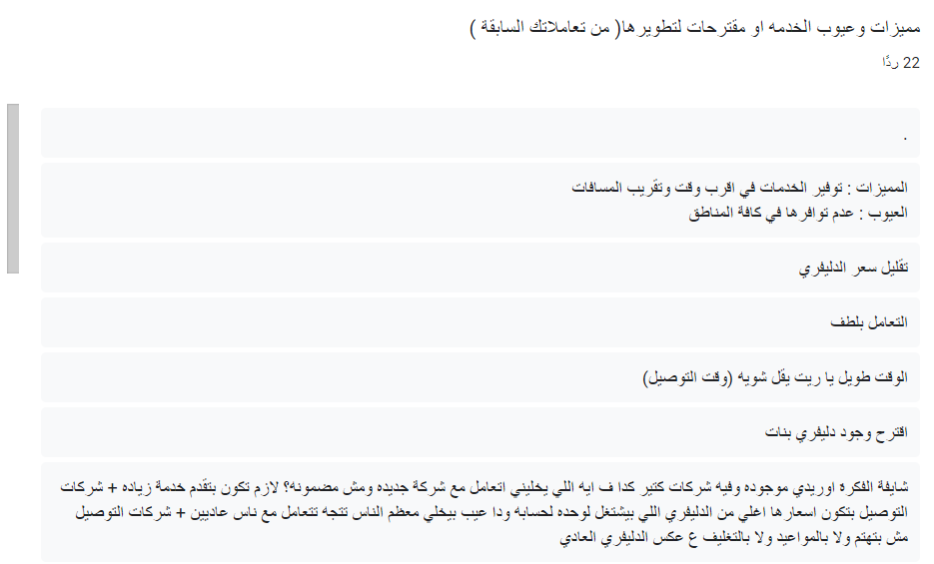
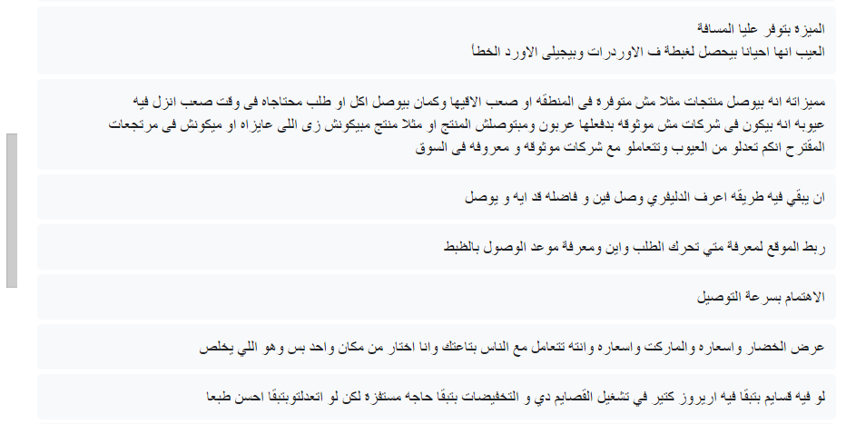
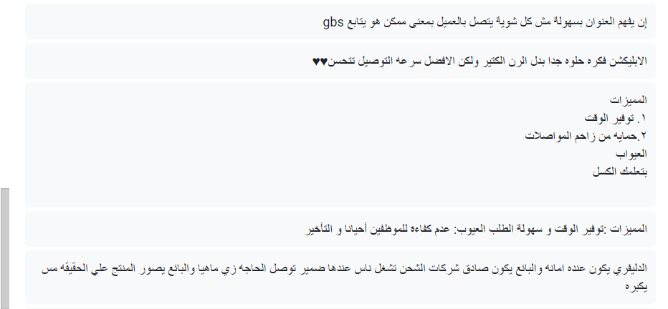
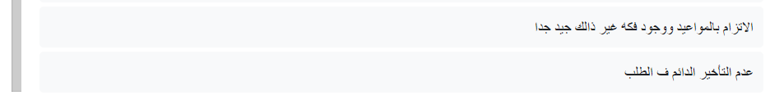
Survey

Slide 7
We Decide to Create
Hatley

Slide 8
Motivation
It helps to make the Egyptian market more competitive, benefiting smaller stores by increasing revenue and product availability.
1
2
The platform provides users with a wide range of products and services, offering them greater choice and flexibility.
job opportunities for young individuals, Hatly contributes to economic growth and development.
3
4
Hatly ensures consumers have convenient access to essential goods and services, enhancing overall market accessibility..
5
Provides users with a wide range of products and services, offering them greater choice and flexibility

Slide 9


Tools and Methodology
Web
Android
IOS
Backend server
We Are Using React JS as main framework
We are developing the Android application in React Native
We are developing the IOS application in React Native
We will use Asp.net as a Backend Framework

Slide 10
System features
User
Delivery
Fair Competition
Competitive Offers
Provider Details
Automatic Location
Multiple Payment Options
Rating and Reviews
Order Tracking
Complaint Center
.
Order Notifications
Order Status
Complaint Submission
Payment Options
.

Slide 11


User Target
1
Busy professionals
Busy professionals who do not have the time to go to multiple stores to purchase their daily essentials
2
Individuals with mobility issues
Hatley is also suitable for individuals with mobility issues who may have difficulty traveling to physical stores
3
Individuals in remote or unserved areas
Hatley can also be a valuable resource for individuals in remote or underserved areas who may have limited access to physical stores

Slide 12
User Target
4
Individuals who want a part time job
Hatley is also suitable for individuals who want a part time job without disciplines.
5
Small and medium size store
Hatley is also suitable for medium size store who can not hire deliveries

Slide 13

Design
QR Code for Design
The Prototype design tailored for the Hatley project has been developed and creatively integrated into the Figma platform

